Slide 1
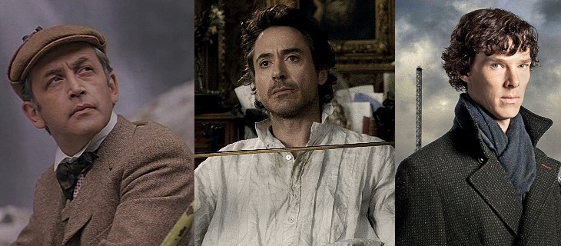
SHERLOCK HOLMES & HIS STORIES
Аверкович Татьяна Петровна, учитель английского языка
МОБУ СОШ №25
МО Кореновский район

Slide 2
For the students aged 14-17
Based on the materials of the British Council
Video audio
transcript Exploring English: transcript Exploring English:): http://learnenglishteens.britishcouncil.org/uk-now/video-uk/sherlock-holmes

Slide 3
Objectives
Speaking: description of the famous detective by Join Wendy in London, sharing the impressions;
Listening for the main idea and specific information;
Vocabulary related to the vidio;
Grammar: Prepositions.
Developing critical thinking, working in pairs and groups.

Slide 4
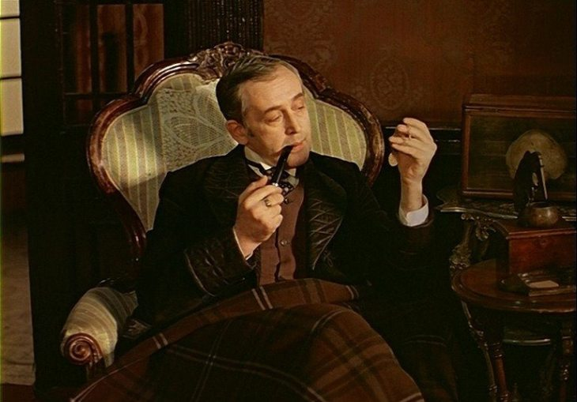
Guess WHO!
Significant
Humorous
Expressive
Realistic
Lancinating
Oracular
Completive
Keen

Slide 5
Guess WHO!
Handsome
Overbold
Longheaded
Masterly
Extraordinary
Splendid

Slide 6
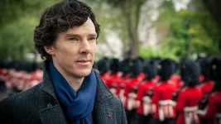
Блиц-опрос
1. Do you like detective stories and mysteries?
2. Which are your favorites'?
3. What do you know about Sherlock Holmes?

Slide 7
MUST BE or HAVE

Slide 8
DEFINE!
1.to murder 2 .to unite 3 .to promise 4 .to discover 5. to wake up | 6.to poison 7. a drug 8. a message 9. sadness 10. dead

Slide 9
What are YOUR associations?
the story of Sherlock Holmes?

Slide 10
Do the preparation task first. Match the words or phrases with the definitions.
What?
1 a cart
foggy
pop in
flawed
be behind something
a blockbuster
out of your mind
ruthless
Means
1 a small, wheeled vehicle, often pulled by a horse
2 full of a weather condition that makes the air cloudy and grey with small particles of water
3 a film that is very popular and makes a lot of money
4 go in or visit for a short time
5 be the person who has secretly organised something
6 to become crazy or confused
7 cruel and having no compassion
8 not perfect

Slide 11
Then watch the video and do the exercises to check your understanding. 1. Are the sentences true or false?
1. Sherlock Holmes was a real person.
2. The books were written in the late 1800s.
3. The author of the books lived at 221B Baker Street.
4. You can visit a pub with a room set up like Sherlock Holmes's study.
5. Roger Johnson thinks the character of Sherlock Holmes is a perfect human.
6. The original stories are very well written.
7. Conan Doyle took his inspiration from real-life crimes.
8. Scientific or forensic policing is now even more important than in Sherlock Holmes's time.

Slide 12
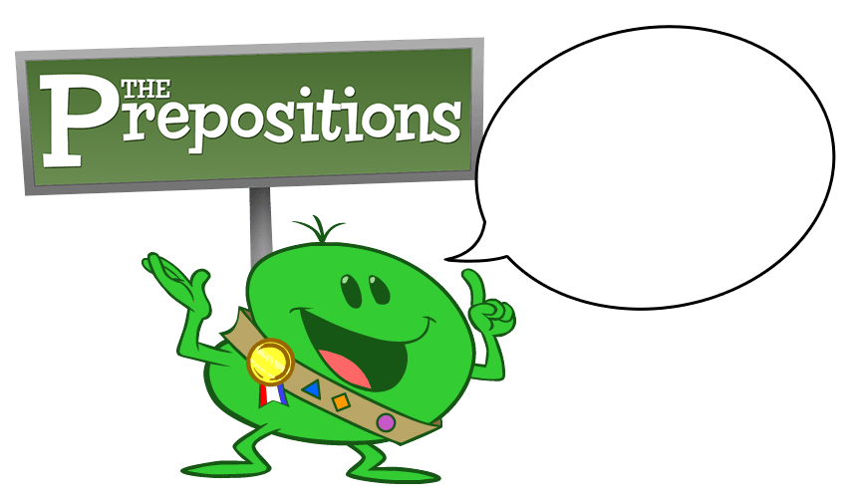
2. Check your vocabulary: gap fill – prepositions Write the correct preposition to fill the gaps.
1.The streets of London are full
history.
2. Since the 1800s, Holmes has appeared many films.
3. You can find evidence of Sherlock Holmes all London.
4. Ah look! A pub named after Sherlock Holmes. Let's pop
5. You can just imagine Sherlock Holmes and Dr Watson discussing how
solve crimes here.
6. 'Whoever's behind this thing must be
of his mind.'
7.
He's a flawed hero. He doesn't have superpowers
the way that, say, Superman does.
8. Holmes was famous
his use of forensic or scientific approaches to solve crimes.

Slide 13
3. Vocabulary Box 3.Write any new words you have learned in this lesson

Slide 14
4 .To find or not to find?
S | C | S | O | B | E | V
T | H | O | S | T | Q | C
M | A | S | T | E | R | O
T | R | U | R | D | W | M
G | A | N | A | P | I | Y
K | C | R | I | M | E | S
M | T | E | F | H | L | T
V | E | A | O | J | I | E
C | R | L | R | U | A | R
X | S | P | D | Z | M | Y

Slide 15
There are SO many things to discover
Sir Arthur Conan Doyle. I hope you are keen on learning more about Sherlock Holmes. Why is it so unique? What was new for you

